Slide 1

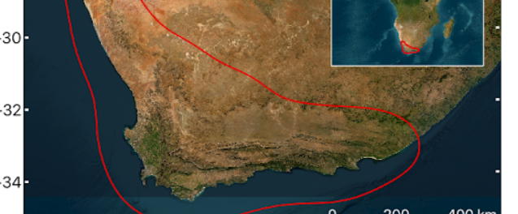
Explore a Biodiversity Hotspot with Imaging Spectroscopy
Team Zephyr
Aadarsh Kumar Agarwal
Dhiren Kanted
Kunal Yadav
Piyush Mohapatra
October 2023

Slide 2
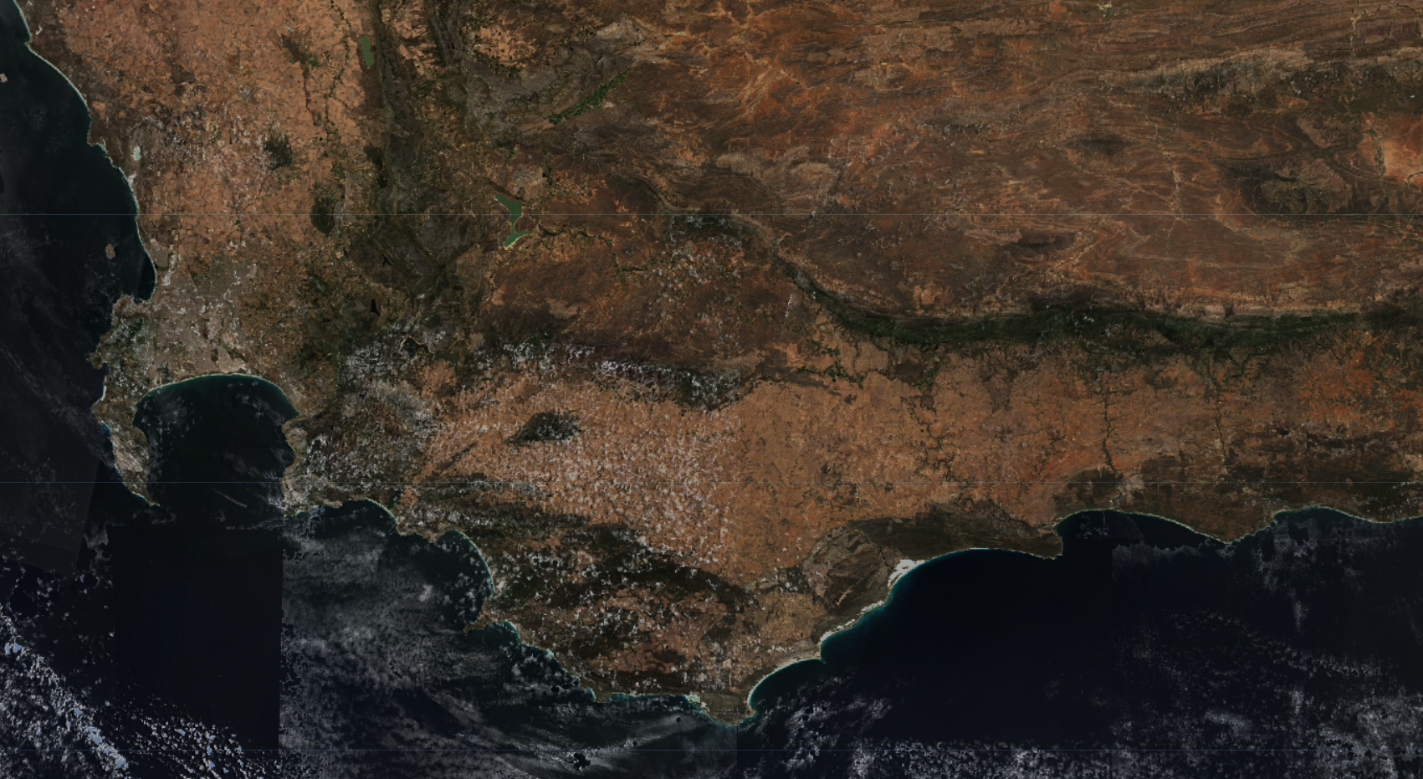
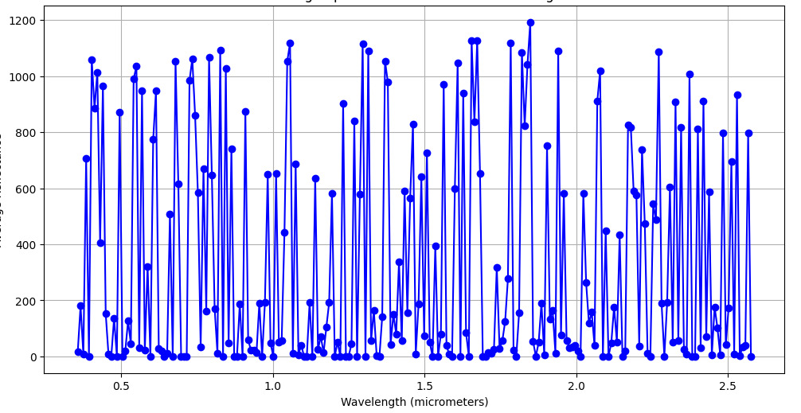
Remote Sensing and Biodiversity
Remote sensing is a powerful tool for exploring biodiversity because it allows researchers to collect data on a large scale, covering vast and often inaccessible areas.
There are several different instruments deployed for this reason generating huge amounts of data every minute.
The data is mostly available through open forums, but the level of preprocessing can be very tedious, to get meaningful information.
We have developed codes to process the various different metrics that will help us visualize the biodiversity, some metrics that we have chosen, for the Cape floristic region, are,
Vegetative Index (NDVI,EVI)
Photosynthetically active radiation
Phenology
Water coverage
Hyperspectral Data
HyperSpectral data for the Cape floristic region (1)
Source: https://sentineldatahub.github.io/DataHubSystem/

Slide 3
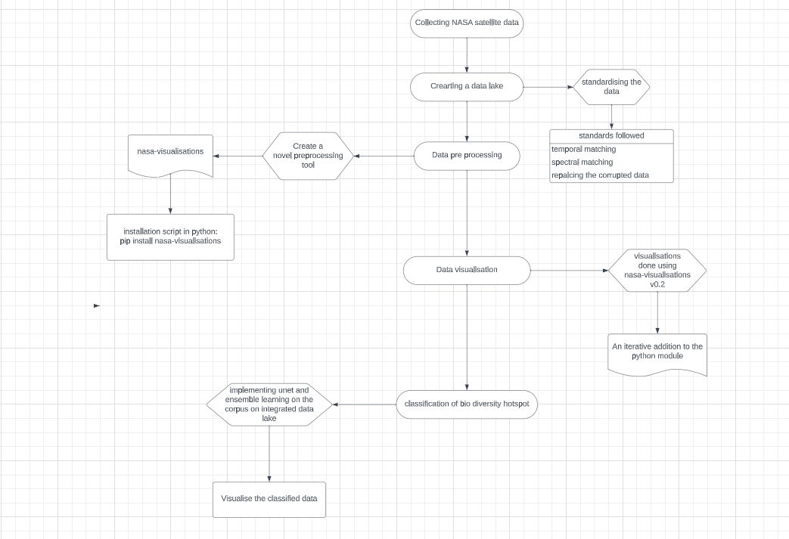
Workflow

Slide 4
Vegetative Indices
Normalized Difference Vegetation Index (NDVI) and Enhanced Vegetation Index (EVI) are two widely used remote sensing indices for monitoring vegetation health and density over time. This is seen here as a visualization of the vegetative indices for the Cape Floristic Region over 2 years (2).

Slide 5
Data visualization of Photosynthetically active radiation, Phenology and Water level of Cape floristic region
PAR over 12 hours (3)
Phenology change over 2 years (4)
Water level over 2 years (5)

Slide 6
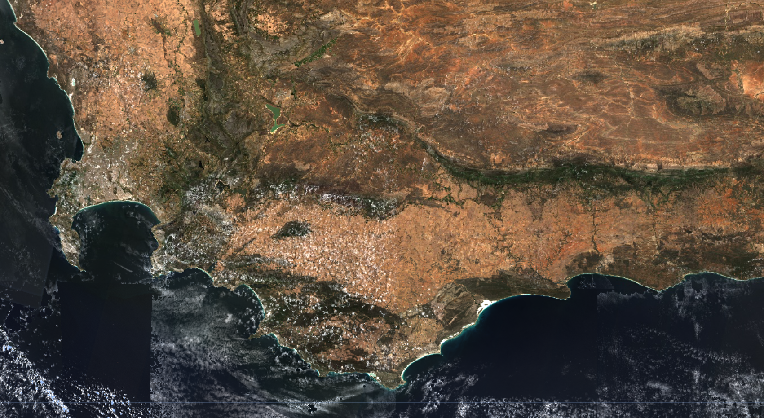
Conclusion and Inferences
Exploring biodiversity through imaging spectroscopy provides a lot of insights that on ground methods miss out on, this works in the opposite way as well, all of these data sets need to be analysed in unison to make meaningful inferences.
Data from remote sensing satellites are available, but the amount of data is huge and complex to process, we have hence developed open source codes to make the data analysis and visualization better.
These codes can be applied to larger data sets to get meaningful inferences to really understand our Biodiversity.
These visualization tools can be extrapolated to train models that might help in predicting various responses.
HyperSpectral data for the Cape floristic region in 3D (1)
Source: https://sentineldatahub.github.io/DataHubSystem/

Slide 7
References
The EO-1 Hyperion Imaging Spectrometer https://data.nasa.gov/dataset/EO-1-Hyperion/ethf-arwz/data
Vermote, E. (2023). VIIRS/JPSS1 Vegetation Indices 16-Day L3 Global 1km SIN Grid V002 [Data set]. NASA EOSDIS Land Processes Distributed Active Archive Center. Accessed 2023-10-08 from https://doi.org/10.5067/VIIRS/VJ113A2.002
Wang, D. (2021). MODIS/Terra+Aqua Photosynthetically Active Radiation Daily/3-Hour L3 Global 1km SIN Grid V061 [Data set]. NASA EOSDIS Land Processes Distributed Active Archive Center. Accessed 2023-10-08 from https://doi.org/10.5067/MODIS/MCD18A2.061
Zhang, X., Friedl, M., Henebry, G. (2020). VIIRS/NPP Land Cover Dynamics Yearly L3 Global 500m SIN Grid V001 [Data set]. NASA EOSDIS Land Processes Distributed Active Archive Center. Accessed 2023-10-08 from https://doi.org/10.5067/VIIRS/VNP22Q2.001
Gao, H. (2021). MODIS/Terra Water Reservoir Monthly L3 Global V061 [Data set]. NASA EOSDIS Land Processes Distributed Active Archive Center. Accessed 2023-10-08 from https://doi.org/10.5067/MODIS/MOD28C3.061
Dr Christopher Lovell (2016). h5py: reading and writing HDF5 files in Python https://www.christopherlovell.co.uk/blog/2016/04/27/h5py-intro.html
Our website: www.datacap.earth
Our coding repository https://github.com/aadarsh73/NASA_Remote_Sensing_Data_Analysis , https://github.com/nugget-cloud/nasa-visualisations
THANK YOU!
Source: https://sentineldatahub.github.io/DataHubSystem/

